Slide 2
Diversity and Inclusion Resolution
Appoint a standing committee
Include different backgrounds
Make recommendations
Develop a strategic plan

Slide 3
Diversity, Equity, and Inclusion
VISION STATEMENT
The IBEW will be a union that welcomes, supports and encourages diversity in our membership and leadership.
We work to organize, fully respect and include all workers, regardless of our identity differences, in order to build a strong and indivisible IBEW for our families and our communities.

Slide 4
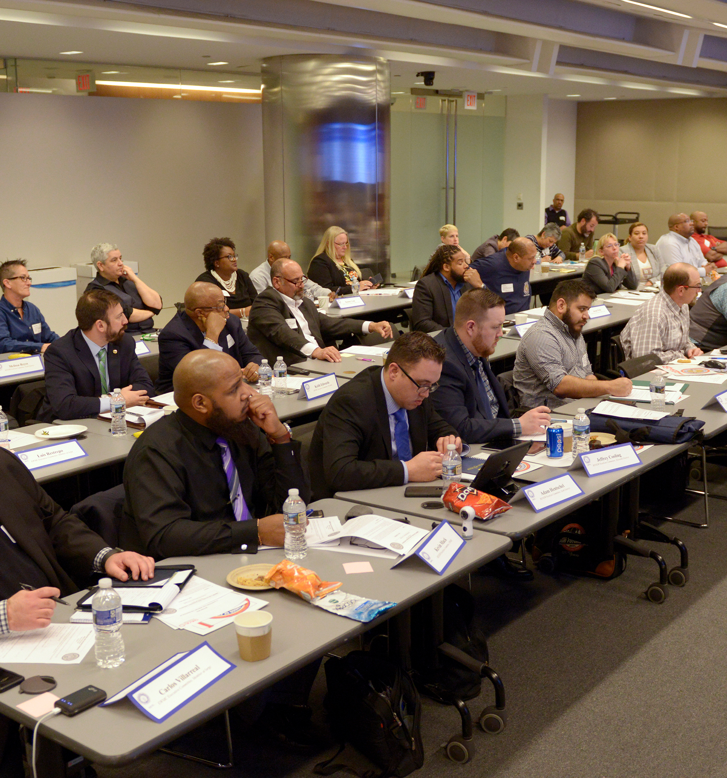
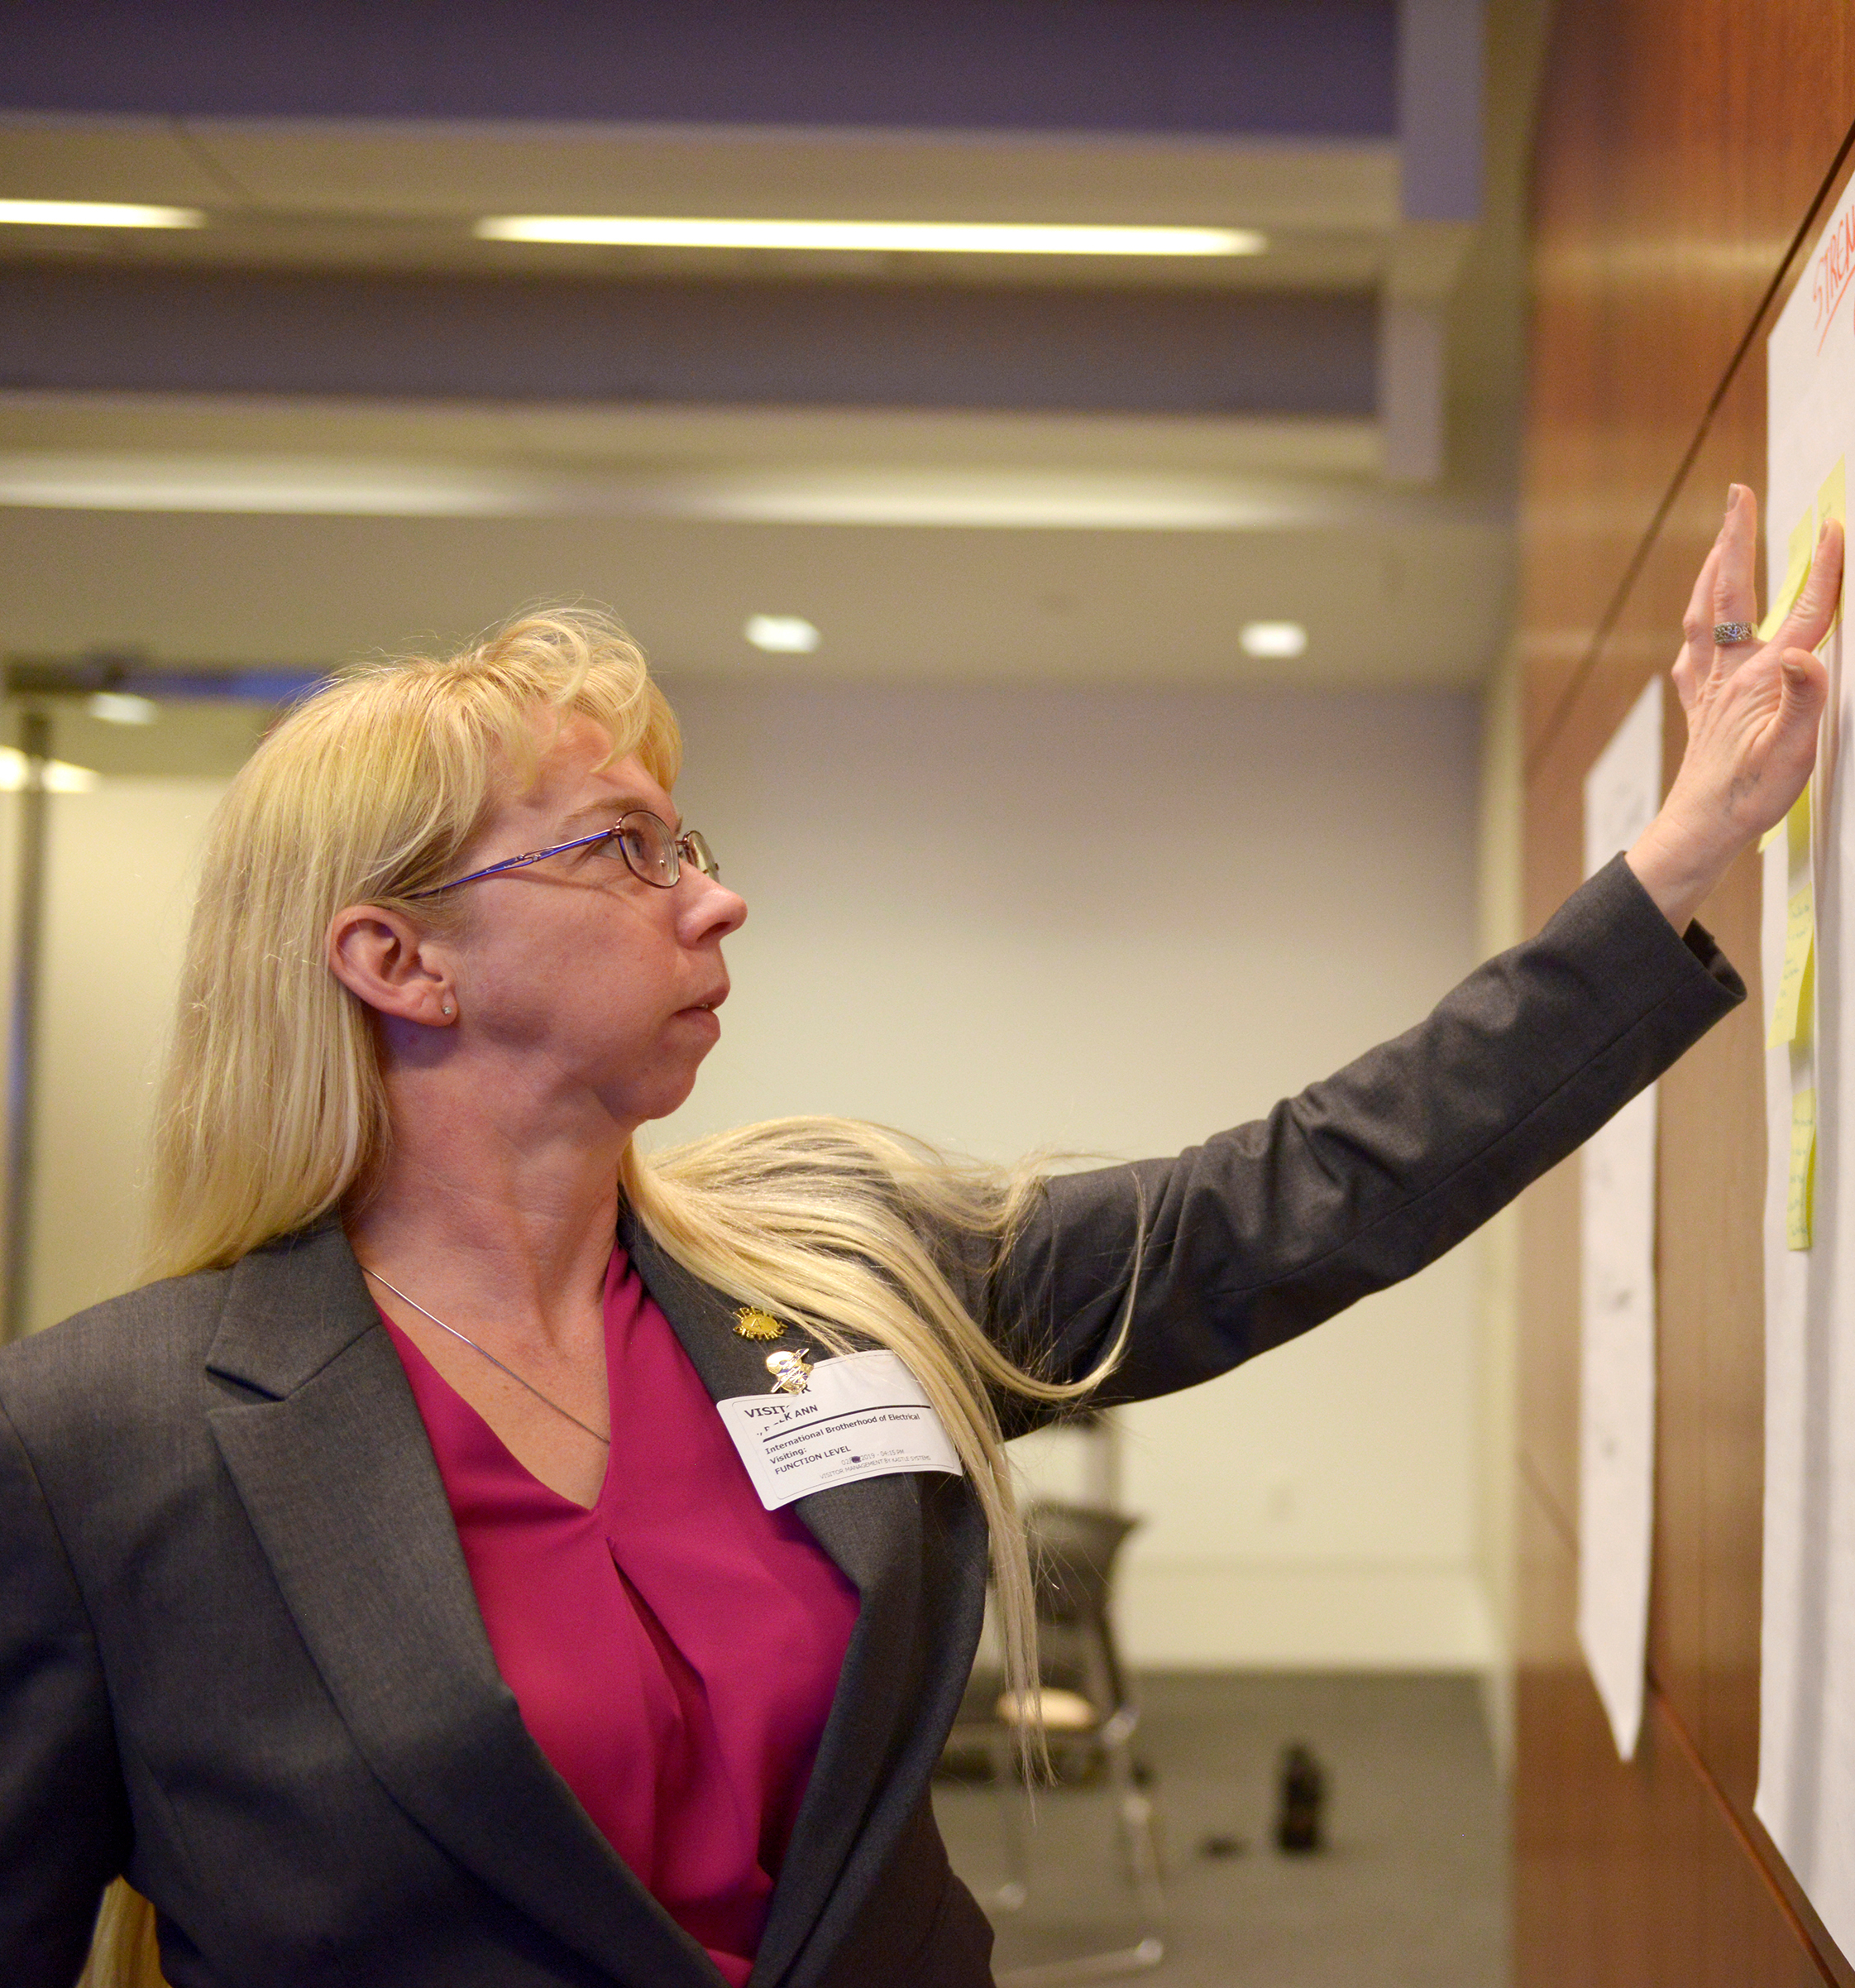

Slide 5
Guiding Principles
#1 Organizing/Expanding Membership
#2 Education and Training
#3 Building Membership Activism/Engagement
#4 Leadership Advancement
#5 Replicating Best Practices – LIFT Campaign

Slide 6
#1 Organizing/Expanding Membership
P Action Items

Slide 8
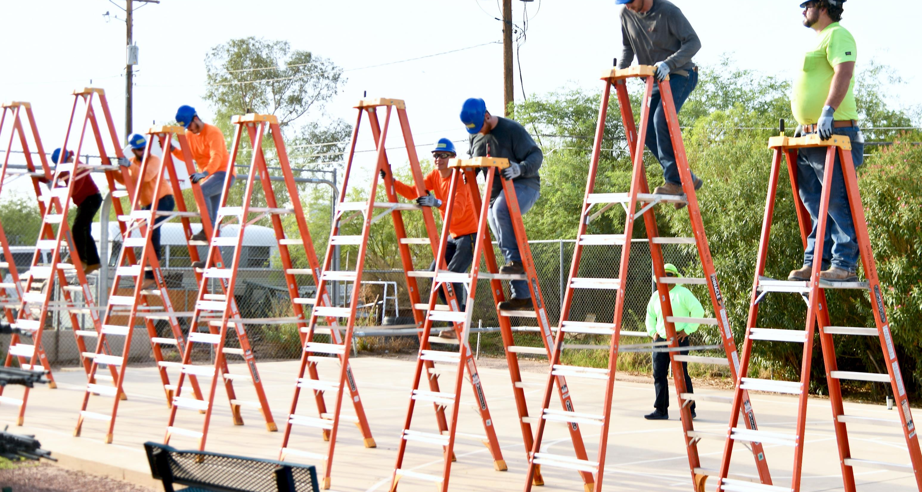
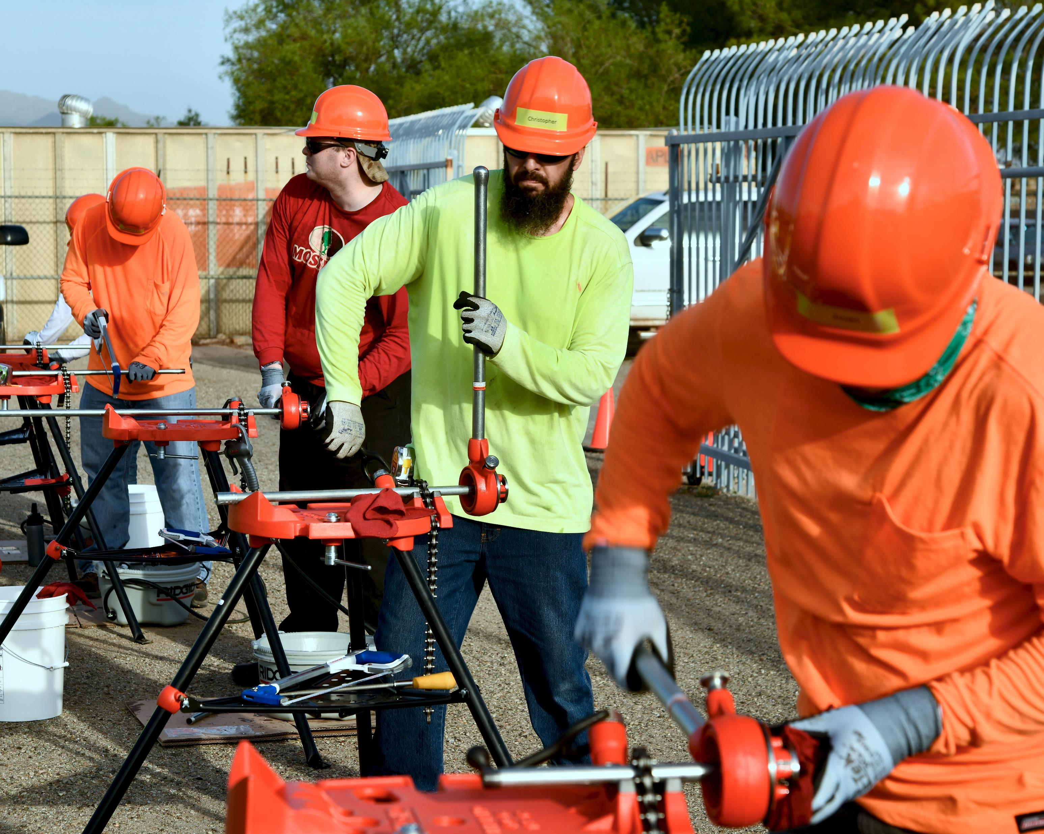
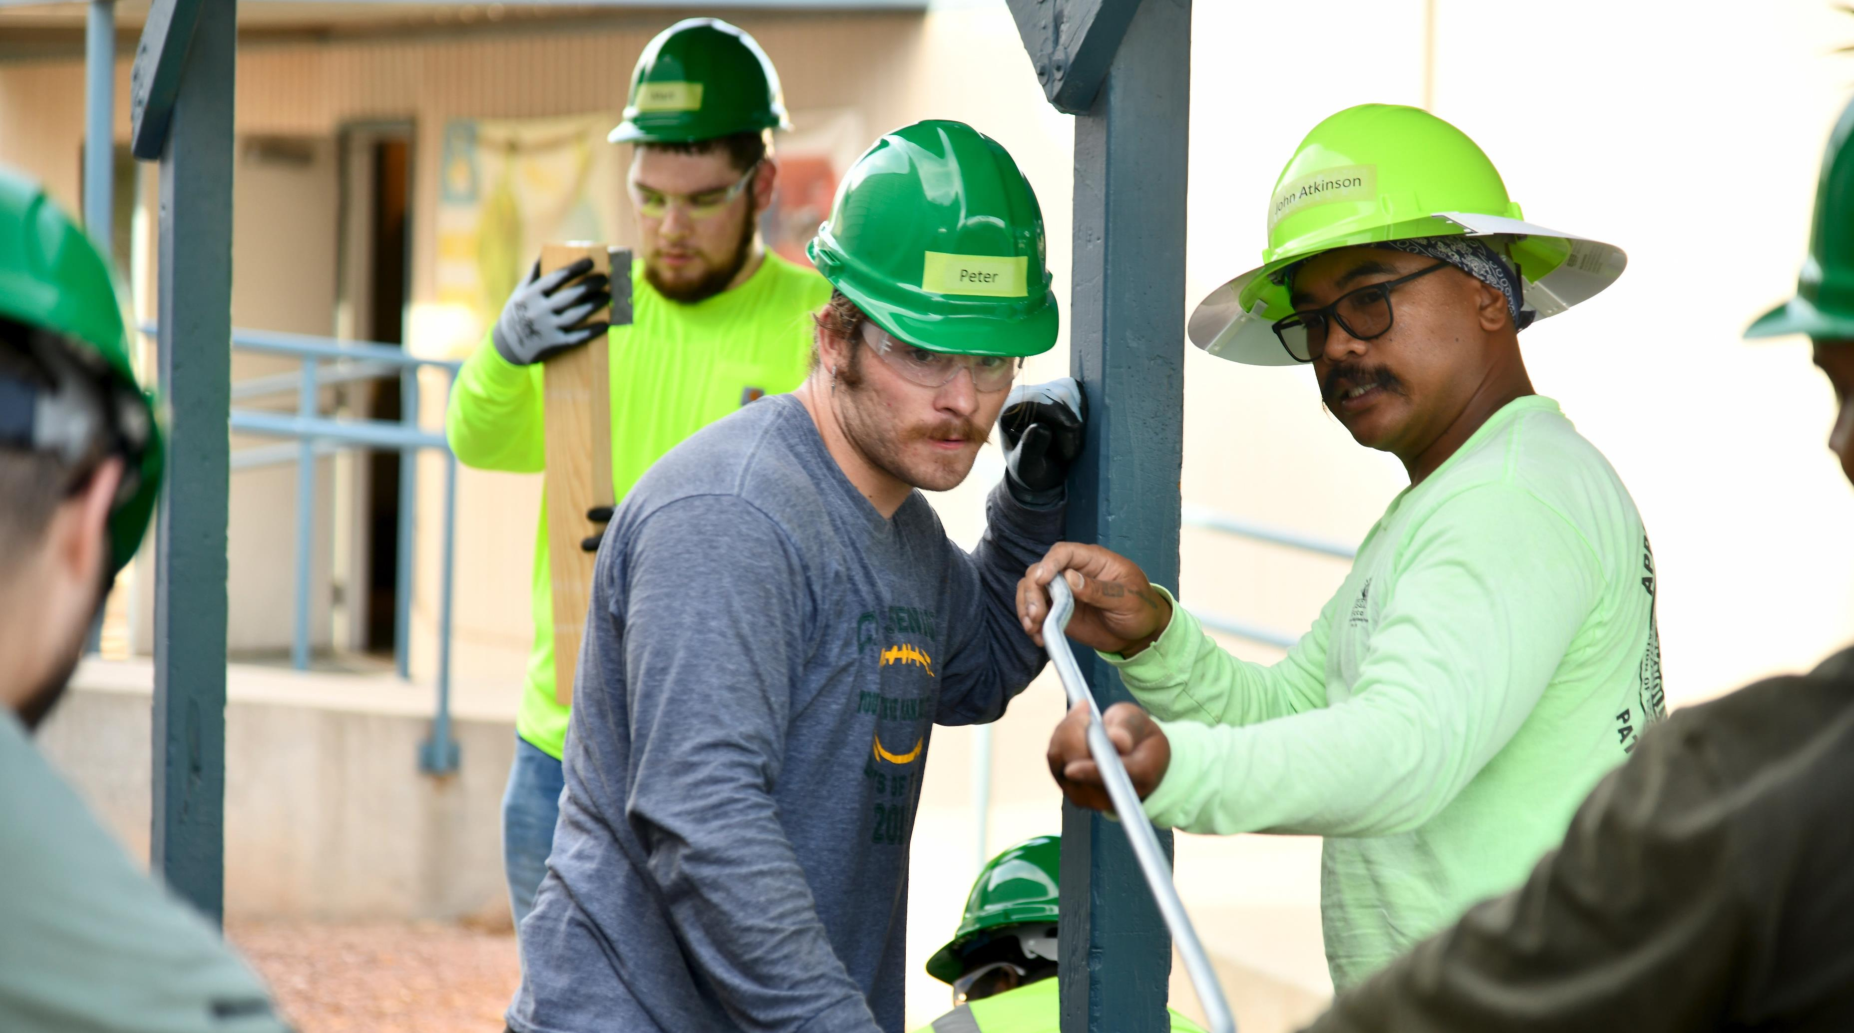

Slide 9
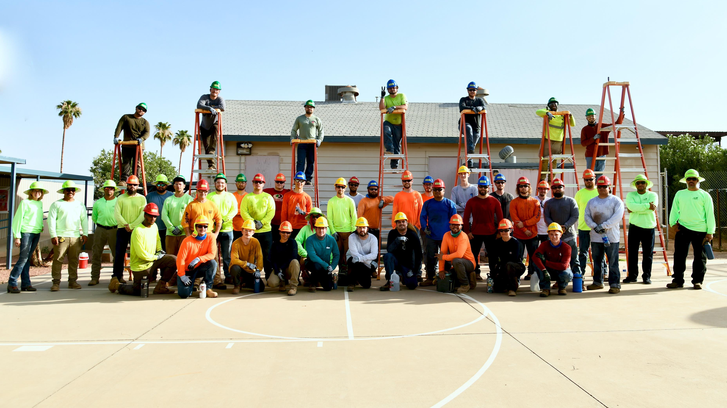

Slide 10
#2 Education and Training
P Action Items

Slide 11
#3 Building Member Activism
and Engagement
P Action Items

Slide 13
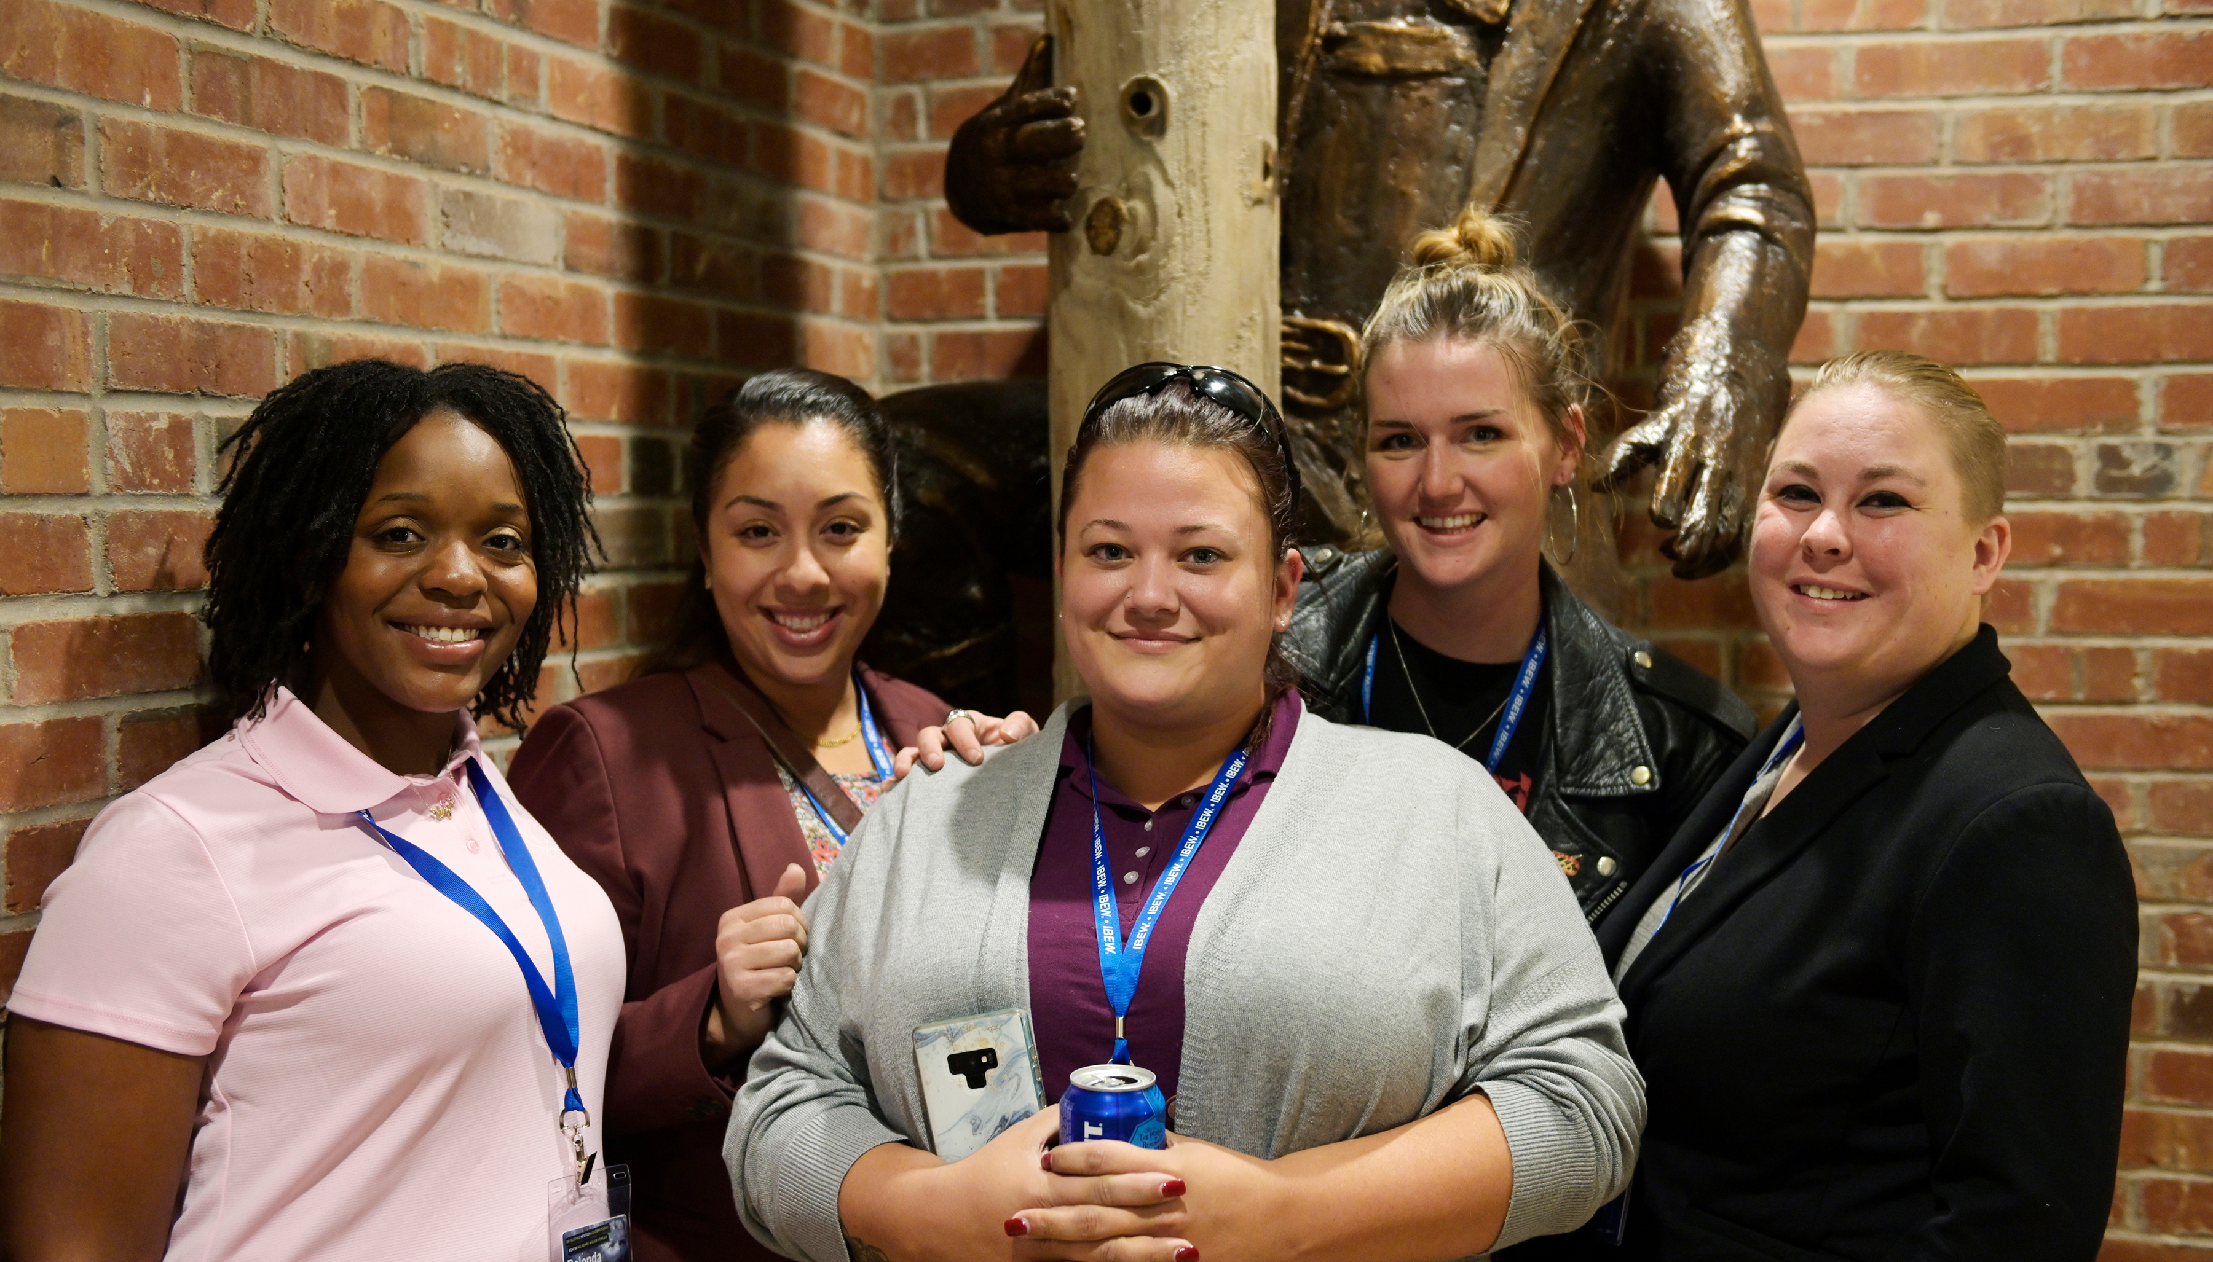
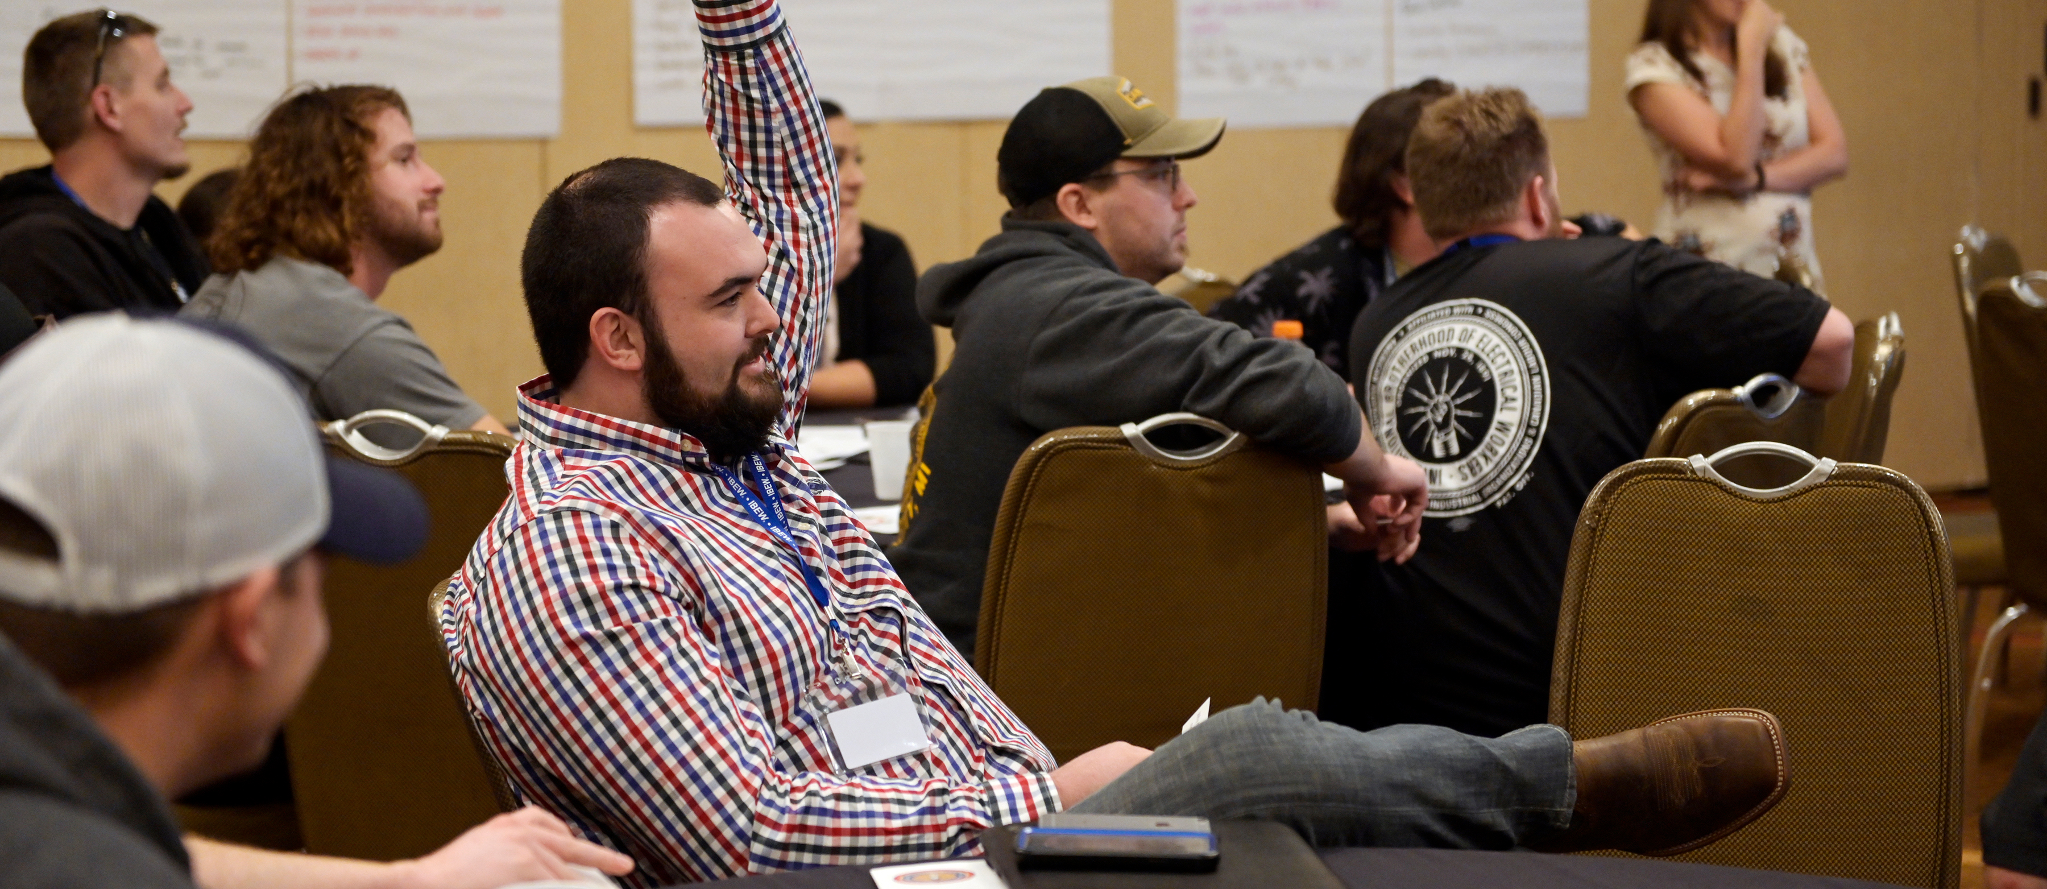
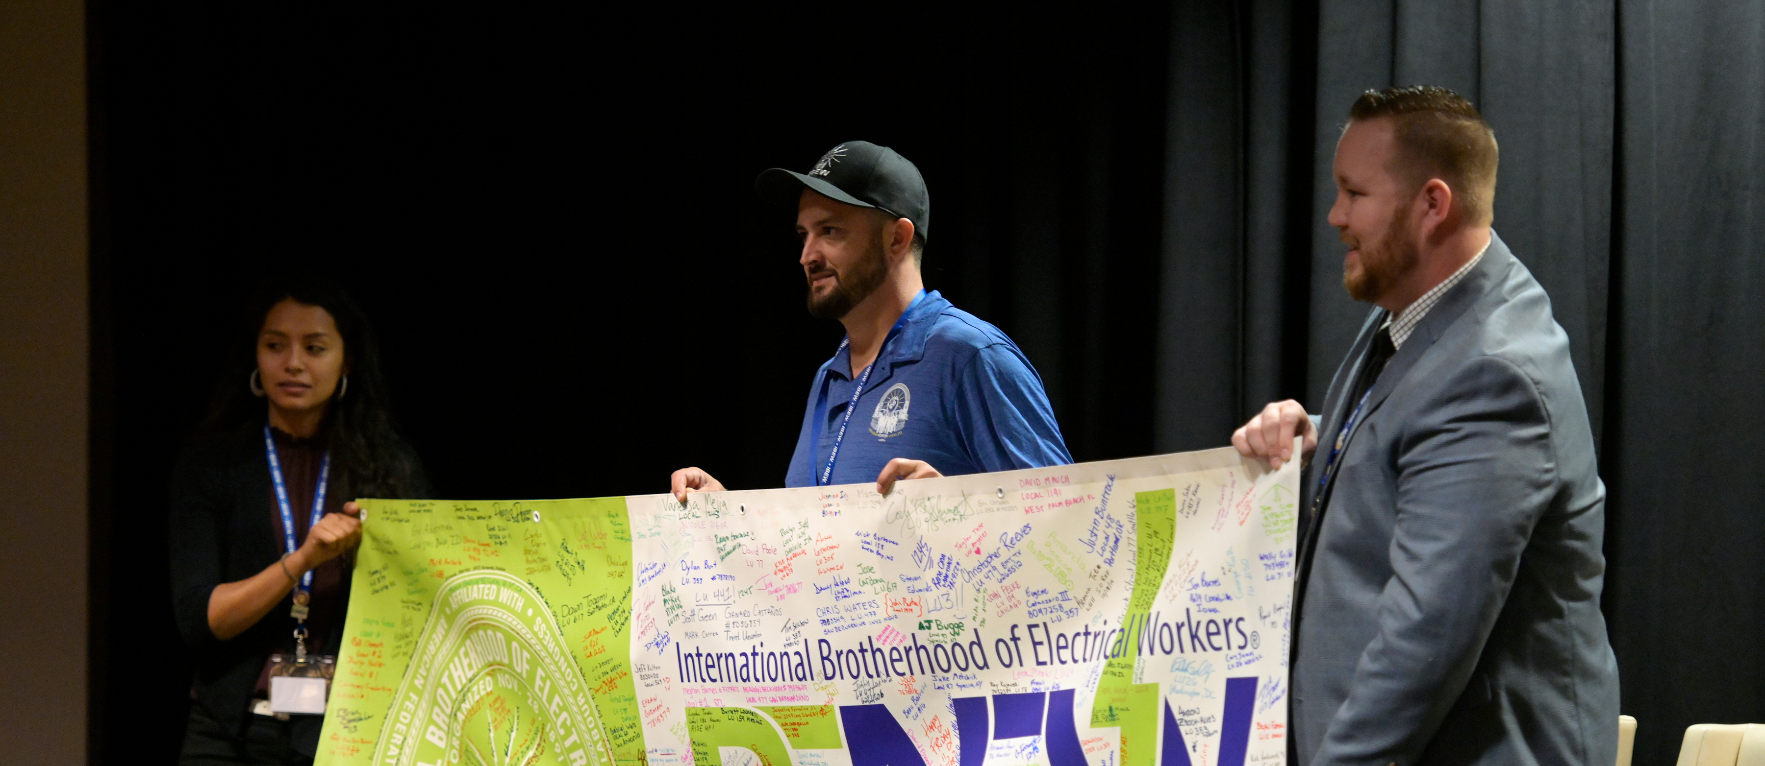
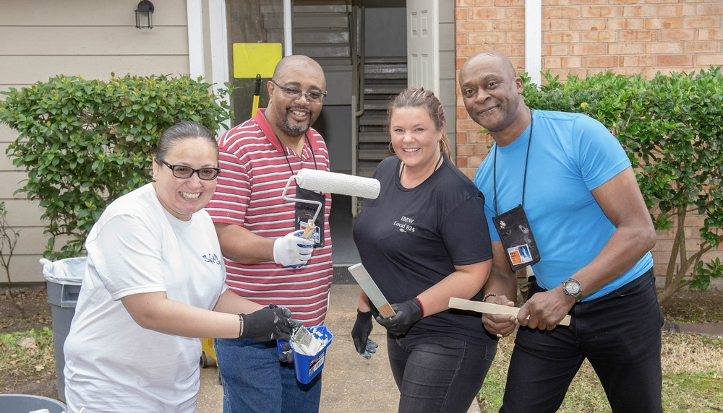

Slide 14
Women’s: Tania McNieve – LU 304
RENEW: Marcus Lundergreen – LU 602
Veterans: Vacancy
EWMC: Vacancy

Slide 15
#4 Leadership Advancement
P Action Items

Slide 16
Pima County WIB - Youth Council
AZ Department of Juvenile Corrections
Goodwill Industries of Southern AZ, Inc.
AZ Department of Corrections Inmate Program Re-entry Division-Education
Pima County CWD and AZ @ Work, Pima County One-Stop Title 1-B Youth
Office of the Pima County School Superintendent
AZ Department of Economic Security, Vocational Rehabilitation
Fred G. Acosta Job Corps Center
Center for the Future of AZ

Slide 17
#5 Replicating Best Practices
P Action Items

Slide 18
Replicating Best Practices – Lift Campaign
School Outreach
Pre-apprenticeship Programs
New Member Orientation
Incarcerated and Returning Citizens

Slide 19
IBEW Strong TODAY
and
NEXT STEPS

